Slide 1


Course title: Data Mining Lab Course Code: CSE 424 Project Title: Diabetes Prediction based on Weka and Python Submitted To: Arpita Das (Lecturer, CSE) Green University Of Bangladesh Submitted by: MD Shahrior Shawon Prio ID: 192002032 Masum Billah ID: 191002053 Dept. of Computer Science and Engineering Green University Of Bangladesh.
Project Presentation

Slide 2
Introduction
The brief of the is about to train dataset into weka and observing the changes on accuracy by applying Decision Tree algorithm and Artificial neural network.
Find the variation of accuracy on Decision Tree algorithm and Artificial neural network and draw 3 graphs
So, we made a project using tools, and the practices that we learned from the lab of this course.

Slide 3
Objective
In this project our general objective id to find the variation of accuracy on Decision Tree algorithm and Artificial neural network and draw 3 graphs.
By 3 differences:
Fold number vs accuracy
Hidden Layers vs accuracy
Training time vs accuracy

Slide 4
Methodology
Applied Algorithm
J48
Multilayer Perception
Decision Tree
Dataset
Process Dataset
Performance Evaluation
Result
Comparative Analysis Based on Accuracy

Slide 5
Tools and Technique
Tools:
Weka 3.8.5 WEKA
Net Beans
Google Colab
Technuics:
Java
python

Slide 6
Description of Dataset
Title: Diabetes Prediction Base on Weka
Number of Instances: 768
Number of Attributes: 9
For Each Attribute: (all numeric-valued)
1. Number of times pregnant
2. Plasma glucose concentration a 2 hours in an oral glucose tolerance test
3. Diastolic blood pressure (mm Hg)
4. Triceps skin fold thickness (mm)
5. 2-Hour serum insulin (mu U/ml)
6. Body mass index (weight in kg/(height in m)^2)
7. Diabetes pedigree function
8. Age (years)
9. Class variable (0 or 1)

Slide 7
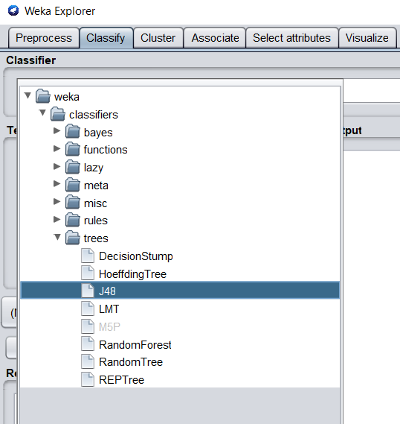
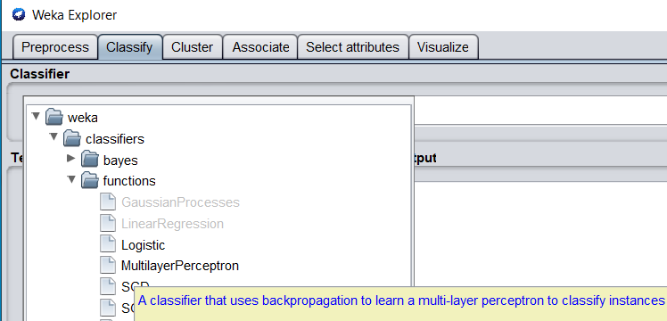
Procedure(j48 for Decision Tree and MultilayerPerception in Weka)

Slide 8
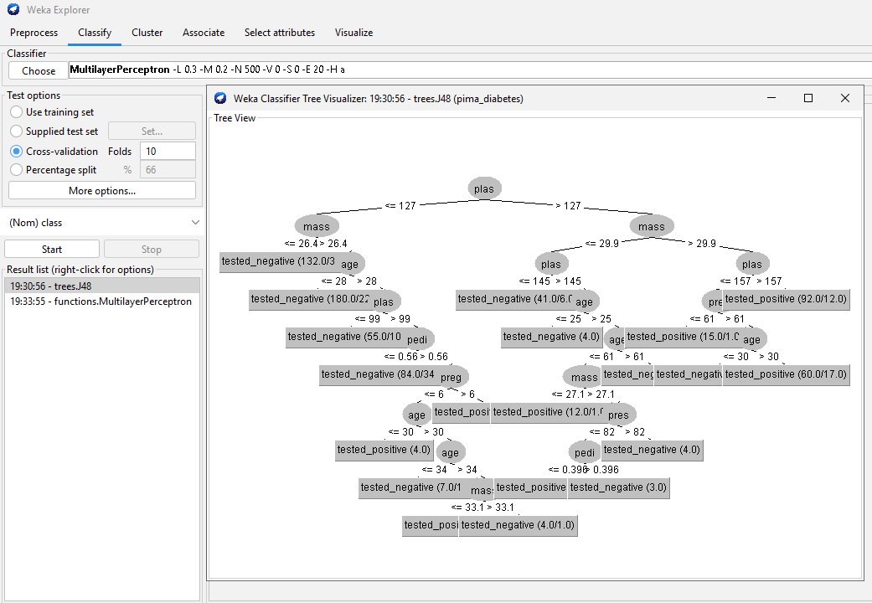
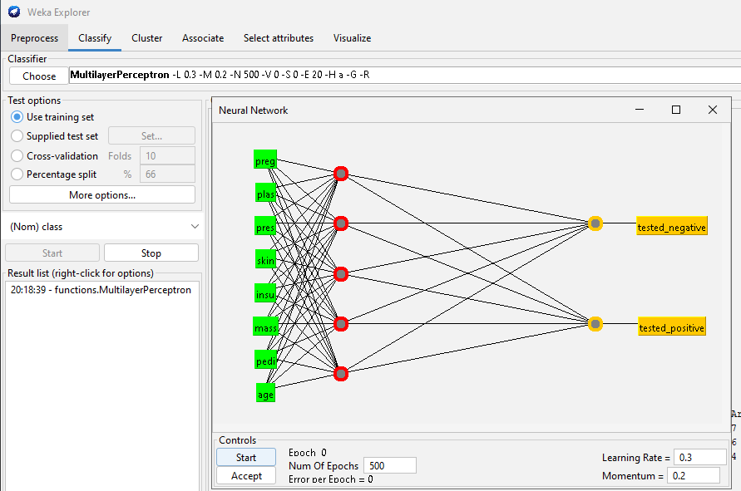
Visualizing Tree and Visualizing Neural Network

Slide 9
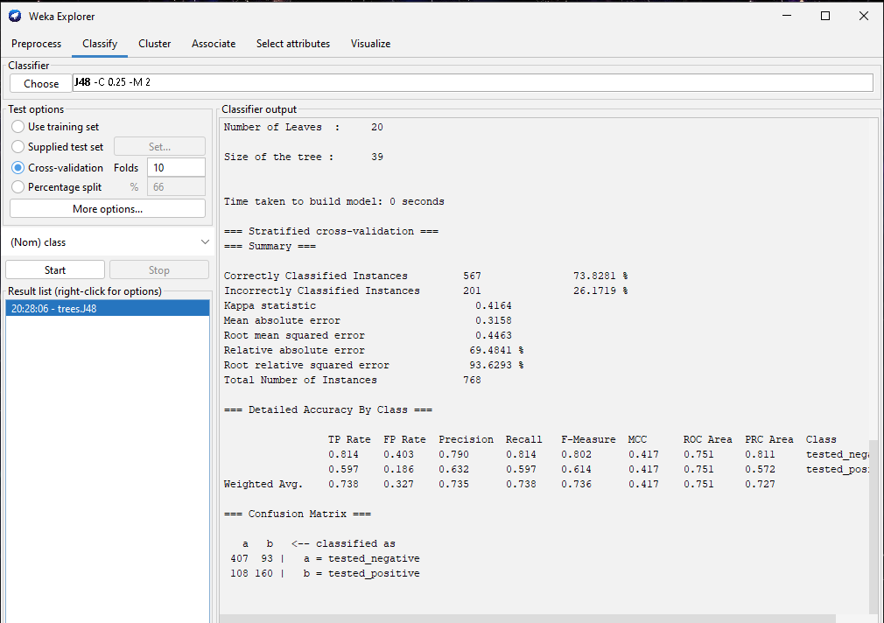
Now setting up five different fold number to determine accuracy(10)

Slide 10
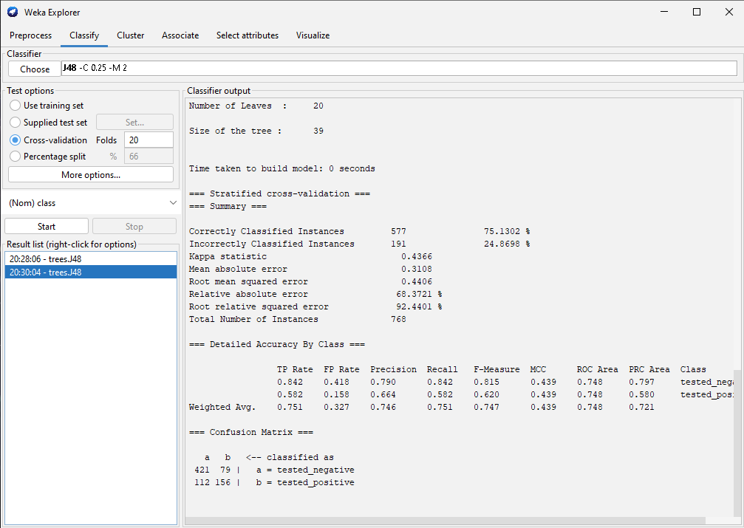
Now setting up five different fold number to determine accuracy(20)

Slide 11
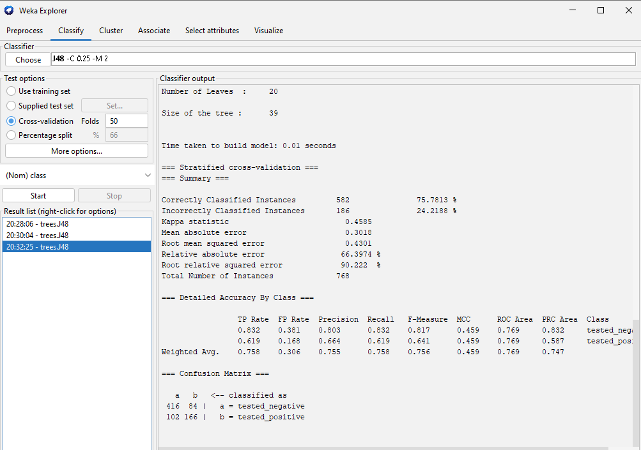
Now setting up five different fold number to determine accuracy(50)

Slide 12
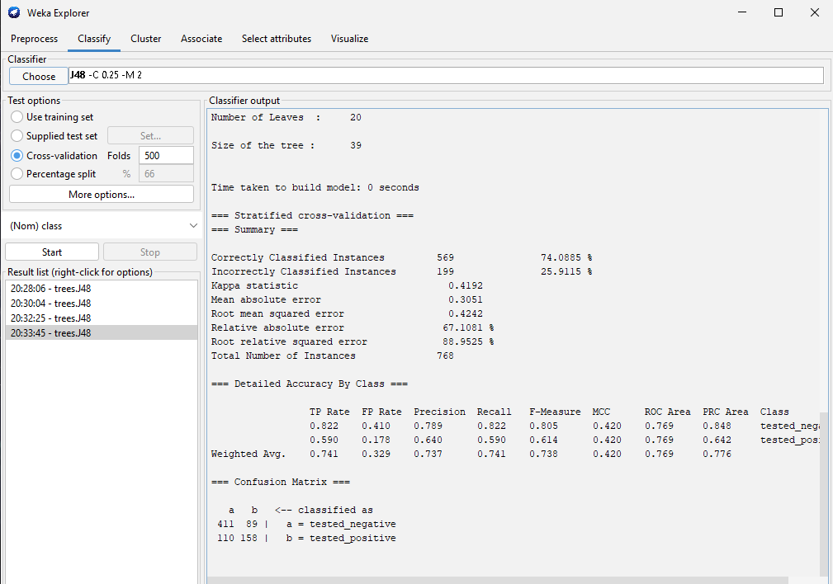
Now setting up five different fold number to determine accuracy(500)

Slide 13
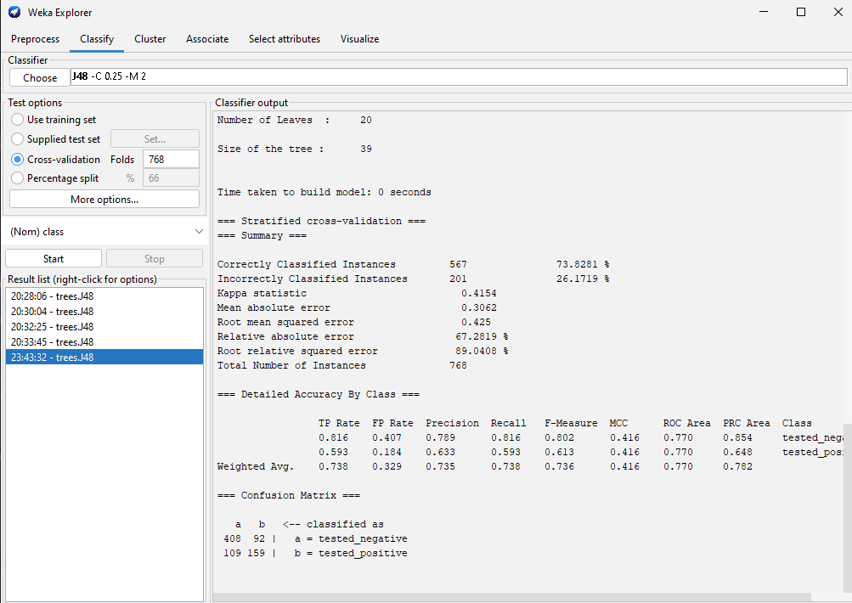
Now setting up five different fold number to determine accuracy(768)

Slide 14
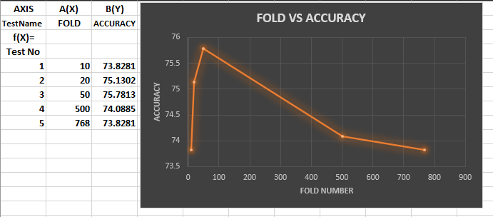
Graph 1: Fold vs Accuracy

Slide 15
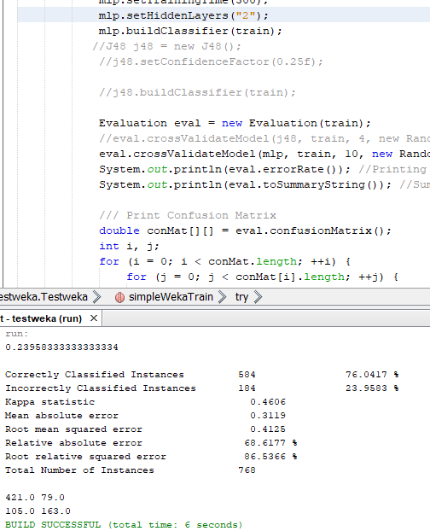
Now setting up five different Hidden Layers to determine accuracy(2)

Slide 16
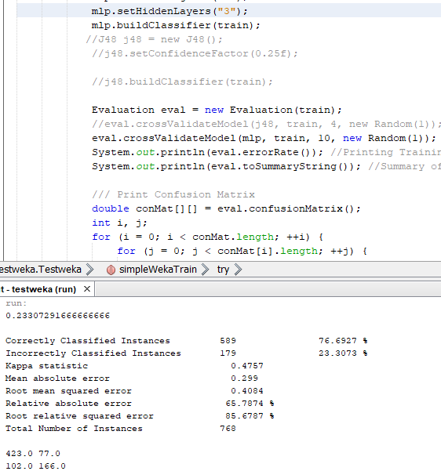
Now setting up five different Hidden Layers to determine accuracy(3)

Slide 17
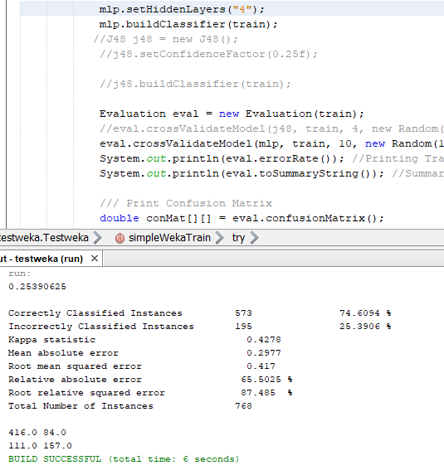
Now setting up five different Hidden Layers to determine accuracy(4)

Slide 18
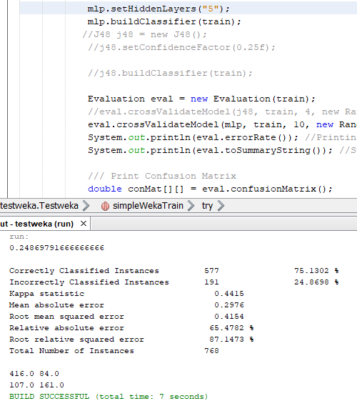
Now setting up five different Hidden Layers to determine accuracy(5)

Slide 19
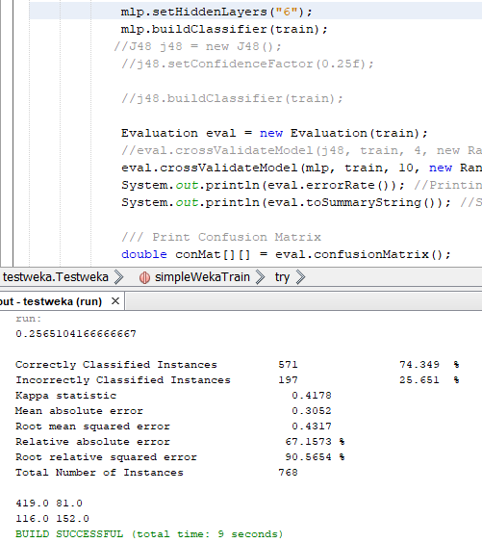
Now setting up five different Hidden Layers to determine accuracy(6)

Slide 20
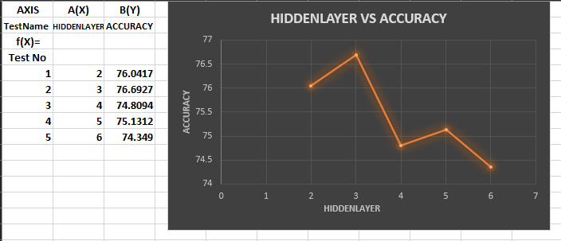
Graph 2: Hidden Layer vs Accuracy

Slide 21
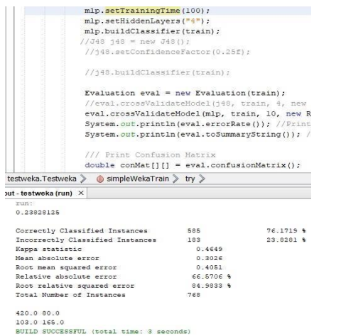
Now setting up five different Training time to determine accuracy(100)

Slide 22
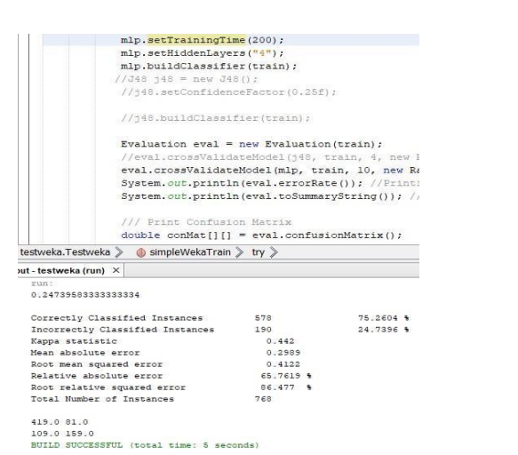
Now setting up five different Training time to determine accuracy(200)

Slide 23
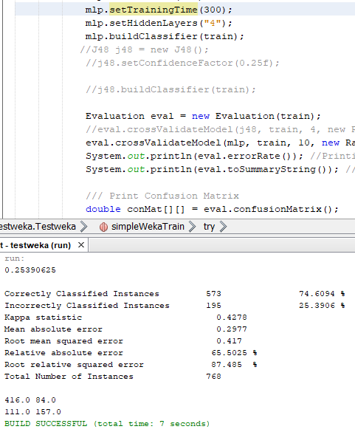
Now setting up five different Training time to determine accuracy(300)

Slide 24
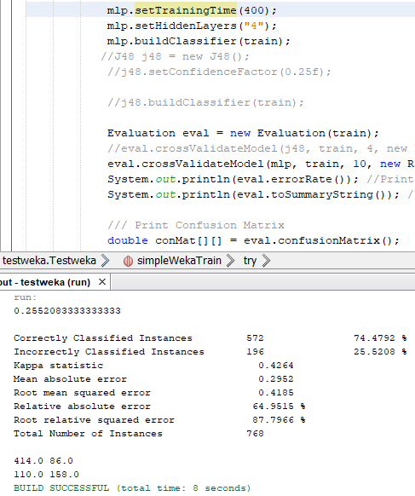
Now setting up five different Training time to determine accuracy(400)

Slide 25
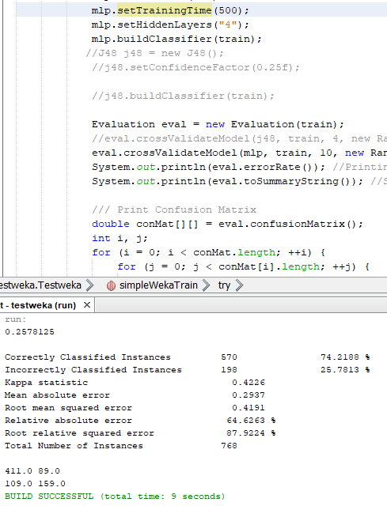
Now setting up five different Training time to determine accuracy(500)

Slide 26
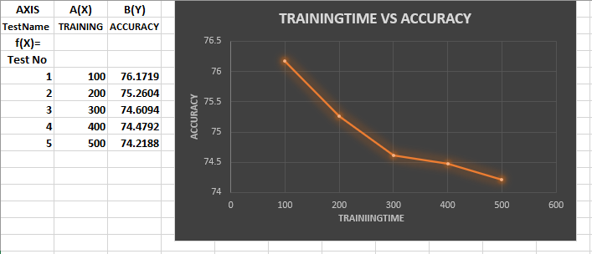
Graph 3: Training Time vs Accuracy

Slide 27
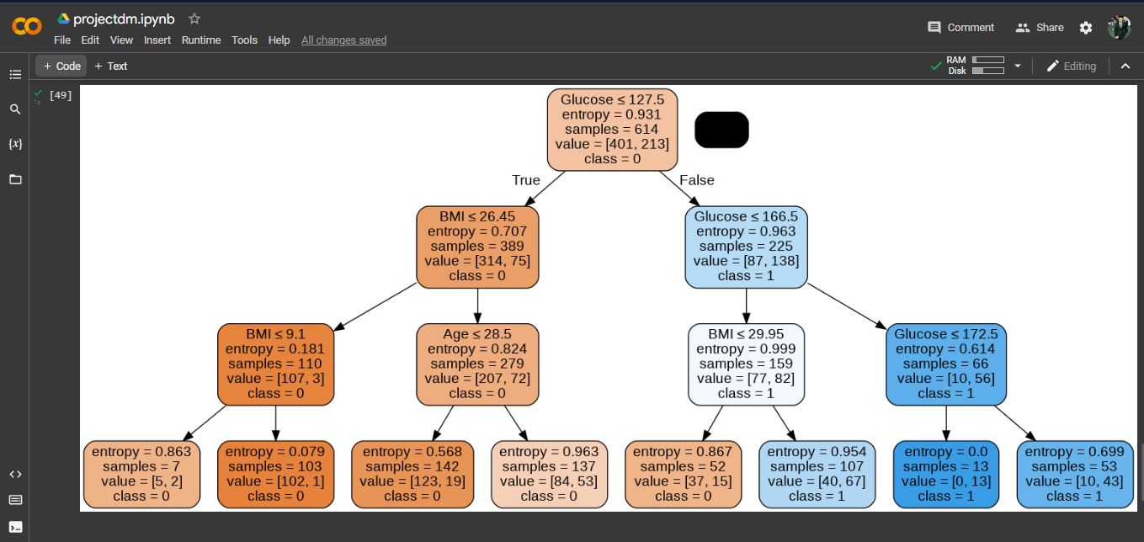
Decision Tree Visualization using Python

Slide 28
Conclusion
While implementing the project we faced some issue on google colab cause sometimes it doesn’t work properly.
The java implementation was kind of easy and accessible.
But we were able to successfully complete the project and it simulates smoothly.

Slide 29
References
Mostly Lecture Slides
https://stackoverflow.com/
https://github.com/
https://YouTube.com
Our code link in colab: https://colab.research.google.com/drive/1K5KEtS_4ujcJ8Rmk74YJ4JiYLnEIdBvJ?usp=sharing

